Slide 1
Cloud Computing
SEWP ZG527

Slide 2

Big Data Growth Drivers
What is Big Data?
Hadoop Introduction
Hadoop Master/Slave Architecture
Hadoop Core Components
HDFS Data Blocks
HDFS Read/Write Mechanism
What is MapReduce
MapReduce Program
MapReduce Job Workflow
Hadoop Ecosystem
AGENDA

Slide 3
1
Big Data Growth Drivers

Slide 4

Big Data EveryWhere!
Lots of data is being collected and warehoused
Web data, e-commerce
purchases at department/ grocery stores
Bank/Credit Card transactions
Social Network

Slide 5
How Much Data
Google processes 20 PB a day
Wayback Machine has 3 PB + 100 TB/month
Facebook has 2.5 PB of user data + 15 TB/day
eBay has 6.5 PB of user data + 50 TB/day
CERN’s Large Hydron Collider (LHC) generates 15 PB a year
1.7MB of data is generated every second by an individual in 2020
Humans produce 2.5 quintillion bytes of data daily
By 2025, humans shall generate 463 exabytes of data Each day:
306.4 billion emails are sent
95 million videos and photos are shared on Instagram
5 million Tweets are made.

Slide 6
Type of Data
Relational Data (Tables/Transaction/Legacy Data)
Text Data (Web)
Semi-structured Data (XML)
Graph Data
Social Network, Semantic Web (RDF), …
Streaming Data
You can only scan the data once

Slide 7
What to do with these data?
Aggregation and Statistics
Data warehouse and OLAP
Indexing, Searching, and Querying
Keyword based search
Pattern matching (XML/RDF)
Knowledge discovery
Data Mining
Statistical Modeling

Slide 8
2
What is Big Data?

Slide 9
Introduction to Big Data
Big Data’ is similar to ‘small data’, but bigger in size but having data bigger it requires different approaches: –
Techniques, tools and architecture with an aim to solve new problems or old problems in a better way
Big Data generates value from the storage and processing of very large quantities of
digital information that cannot be analyzed with traditional techniques
Big Data may well be the Next Big Thing in the IT world.
Big data burst upon the scene in the first decade of the 21st century.
The first organizations to embrace it were online and startup firms.
Firms like Google, eBay, LinkedIn, and Facebook were built around big data from the beginning.
Like many new information technologies, big data can bring about dramatic cost reductions, substantial
improvements in the time required to perform a computing task, or new product and service offerings.

Slide 10
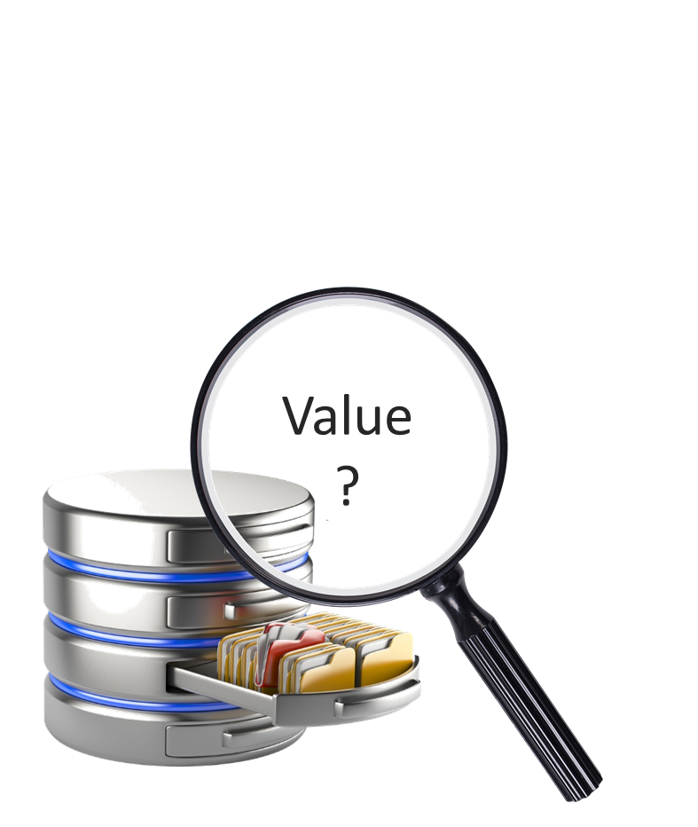


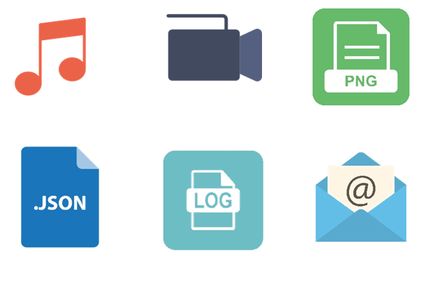
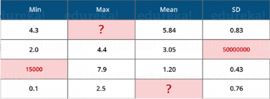
What is Big Data?
Volume
Variety
Velocity
Value
Veracity
Processing increasing huge data sets
Processing different types of data
Data is being generated at an alarming rate
Finding correct meaning out of the data
Uncertainty and inconsistencies in data
“Big data is the term for a collection of data sets so large and complex that it becomes difficult to process using on-hand database management tools or traditional data processing applications”

Slide 11
Big Data Volume
A typical PC might have had 10 gigabytes of storage in 2000.
Today, Facebook ingests 500 terabytes of new data every day.
Boeing 737 will generate 240 terabytes of flight data during a single flight
across the US.
The smart phones, the data they create and consume;
sensors embedded into everyday objects will soon result in billions of new,
constantly-updated data feeds containing environmental, location, and other
information, including video

Slide 12
Big Data Velocity
Clickstreams and ad impressions capture user behaviour at
millions of events per second
• high-frequency stock trading algorithms reflect market
changes within microseconds
• machine to machine processes exchange data between
billions of devices
• infrastructure and sensors generate massive log data in
realtime
• on-line gaming systems support millions of concurrent users,
each producing multiple inputs per second.

Slide 13
Big Data Variety
Big Data isn't just numbers, dates, and strings.
Big Data is also geospatial data, 3D data, audio and
video, and unstructured text, including log files and
social media.
Traditional database systems were designed to address
smaller volumes of structured data, fewer updates or a
predictable, consistent data structure.
Big Data analysis includes different types of data

Slide 14
Storing Big Data
Choosing the correct data stores based on your data characteristics
Analyzing your data characteristics
• Selecting data sources for analysis
Moving code to data
• Implementing polyglot data store solutions
• Aligning business goals to the appropriate data store
• Eliminating redundant data
Overview of Big Data stores
• Data models: key value, graph, document, column-family
• Hadoop Distributed File System,Hbase and Hive

Slide 15
Processing Big Data
Integrating disparate data stores
• Mapping data to the programming framework
• Connecting and extracting data from storage
• Transforming data for processing
• Subdividing data in preparation for Hadoop MapReduce
Employing Hadoop MapReduce
• Creating the components of Hadoop MapReduce jobs
• Distributing data processing across server farms
• Executing Hadoop MapReduce jobs
• Monitoring the progress of job flows

Slide 16
3
Introduction to Apache Hadoop
Framework to Process Big Data

Slide 17
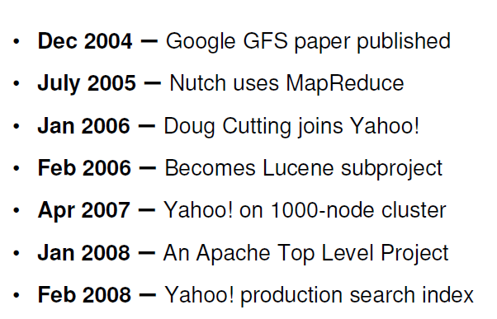
Hadoop History

Slide 18
What is Hadoop
Hadoop is a simple software framework for distributed processing of large datasets across huge clusters of (commodity hardware) computers :
Large datasets → Terabytes or petabytes of data
Large clusters → Hundreds or thousands of nodes
Open-source implementation for Google MapReduce
Simple programming model : MapReduce
Simple data model: flexible for any data

Slide 19
HDFS File System Properties
Large Space: An HDFS instance may consist of thousands of server machines for storage
Replication: Each data block is replicated
Failure: Failure is norm rather than exception
Fault Tolerance: Automated detection of faults and recovery

Slide 20
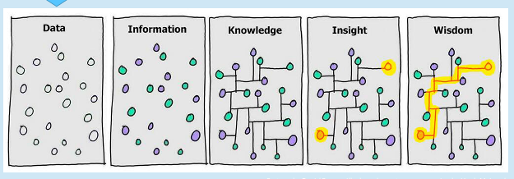
Data Processing Stages

Slide 21
Summary : Hadoop vs. Typical DB
Hadoop Vs RDBMS
 | Distributed DBs | Hadoop
Computing Model | Notion of transactions Transaction is the unit of work ACID properties, Concurrency control | Notion of jobs Job is the unit of work No concurrency control
Data Model | Structured data with known schema Read/Write mode | Any data format ReadOnly mode
Cost Model | Expensive servers | Cheap commodity machines
Fault Tolerance | Failures are rare Recovery mechanisms | Failures are common over thousands of machines Simple fault tolerance
Key Characteristics | - Efficiency, Powerful, optimizations | - Scalability, flexibility, fault tolerance

Slide 22
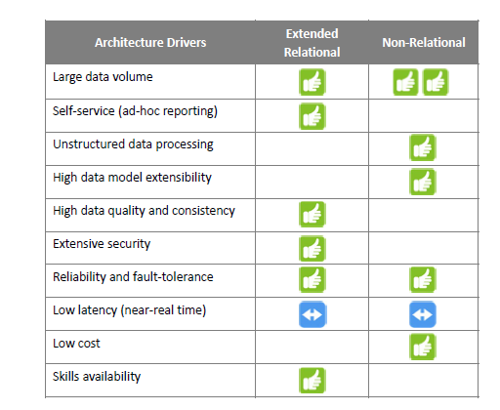
Comparison between Relational and Non-Relational DB

Slide 23
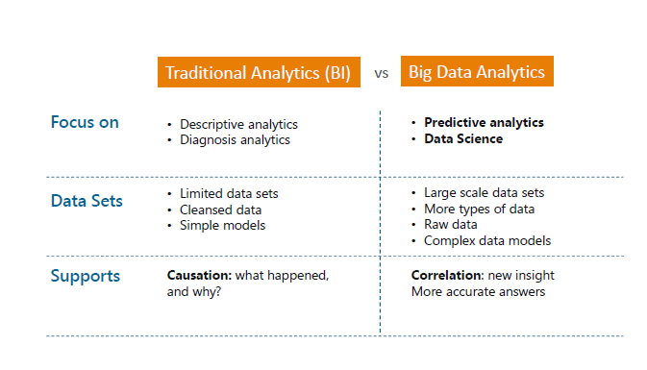
Big Data Analytics

Slide 24
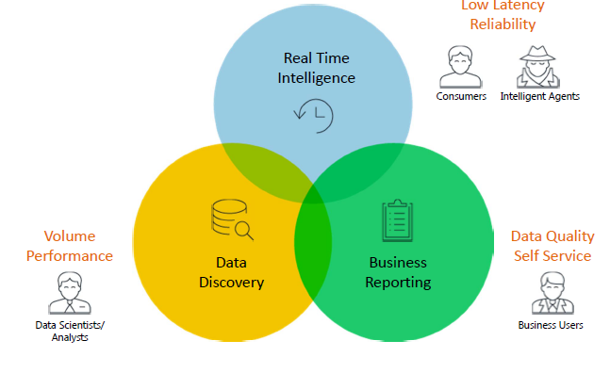
Big Data use case

Slide 25
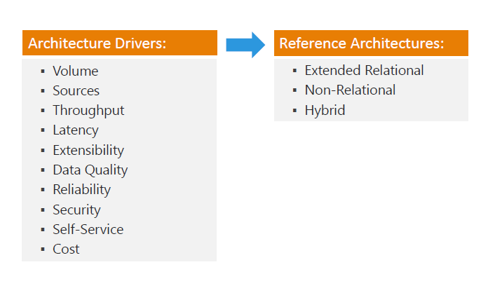
Big Data Analytics Reference Architecture

Slide 26
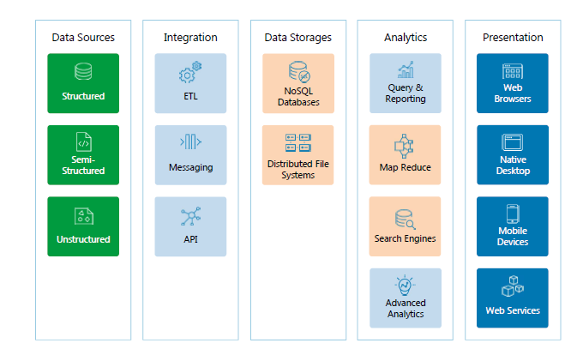
Non-Relational Reference Architecture

Slide 27
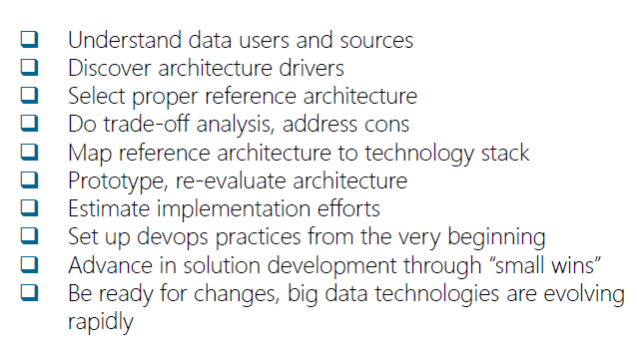
Big Data Design Principles

Slide 28
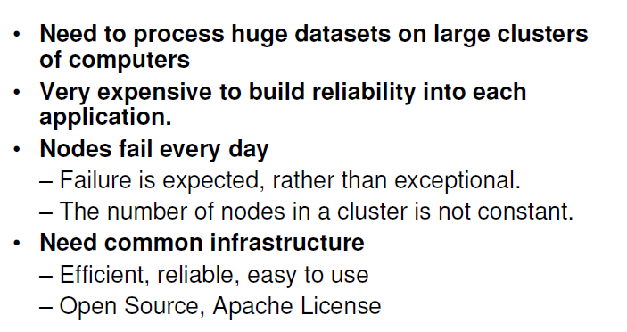
Why Hadoop

Slide 29
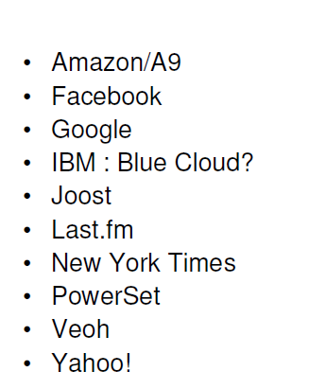
Who Uses Hadoop

Slide 30
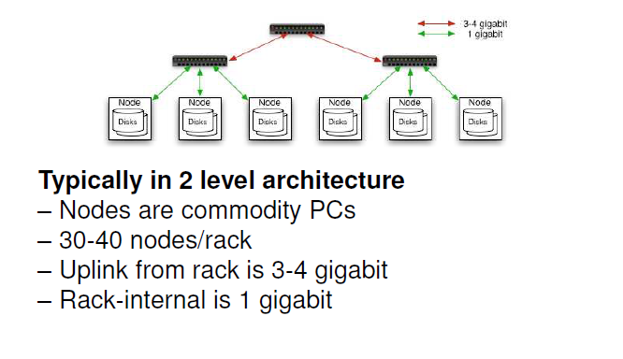
Commodity Hardware

Slide 31
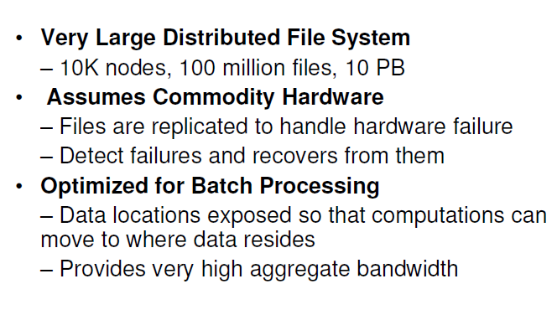
Goal of HDFS

Slide 32
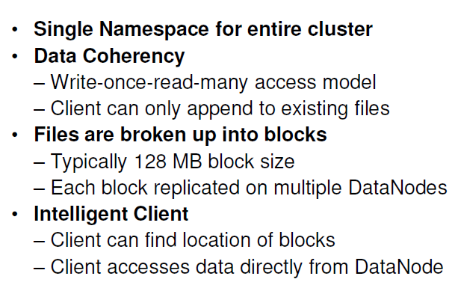
Distributed File System

Slide 33






Apache Hadoop Architecture
Hadoop is a framework that allows us to store and process large data sets in parallel and distributed fashion
HADOOP
Storage:
Distributed File System
Processing:
Allows parallel & distributed processing

Slide 34
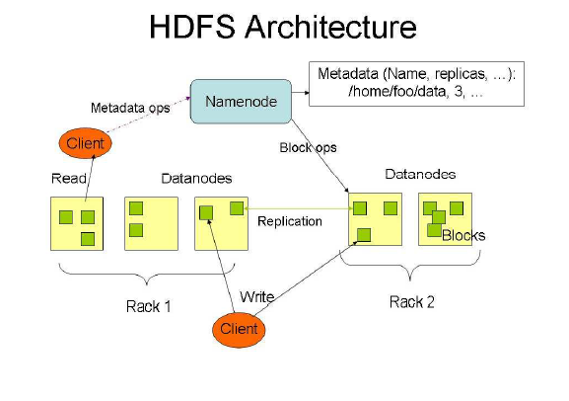
HDFS Architectue

Slide 35


4
Hadoop Core Components

Slide 36
Hadoop Core Components
Storage:
Distributed File System
Processing:
Allows parallel & distributed processing

Slide 37
Hadoop Core Components
Storage:
Distributed File System
Processing:
Allows parallel & distributed processing

Slide 38
5
HDFS Core Components

Slide 39
HDFS Core Components
01
02
03
NameNode
DataNode
Secondary NameNode

Slide 40
NameNode:
Maintains and Manages DataNodes
Records metadata i.e. information about data blocks e.g. location of blocks stored, the size of the files, permissions, hierarchy, etc.
Receives heartbeat and block report from all the DataNodes
DataNode:
Slave daemons
Stores actual data
Serves read and write requests from the clients
NameNode
Secondary NameNode
DataNode
DataNode
DataNode
NameNode & Data Node

Slide 41
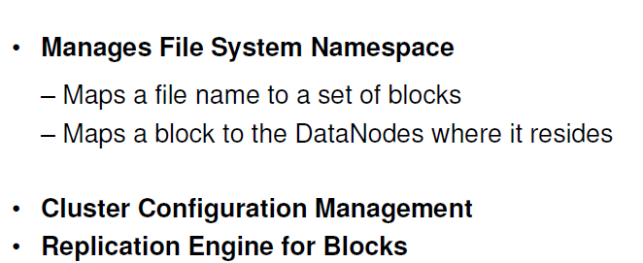
Function of Name Node

Slide 42
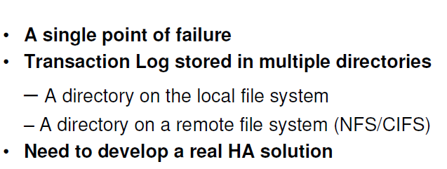
Name Node Failures

Slide 43
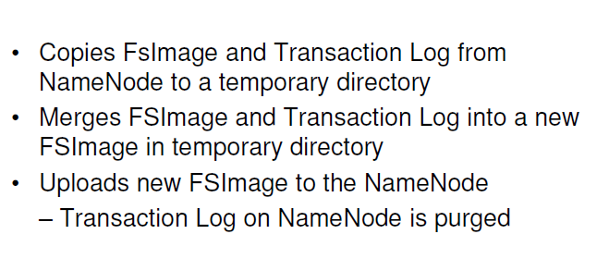
Secondary NameNode
Hadoop FS-Image- FsImage is a file stored on the OS filesystem that contains the complete directory structure (namespace) of the HDFS with details about the location of the data on the Data Blocks and which blocks are stored on which node. This file is used by the NameNode when it is started.

Slide 44
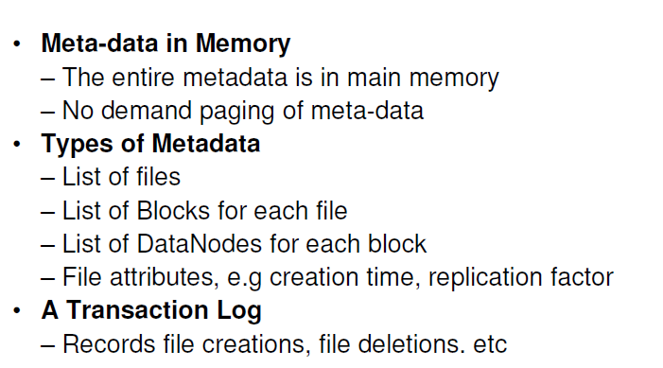
Name Node Meta Data

Slide 45
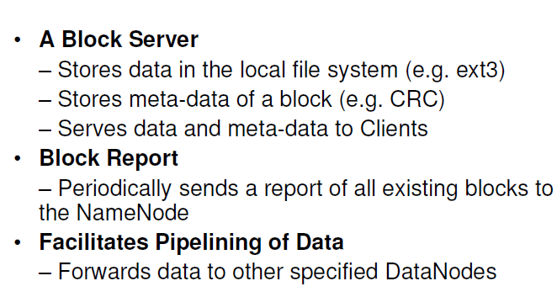
Data Node

Slide 46
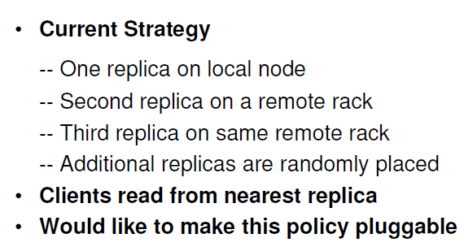
Block Placement

Slide 47
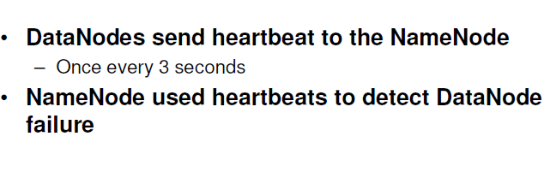
HeartBeats

Slide 48
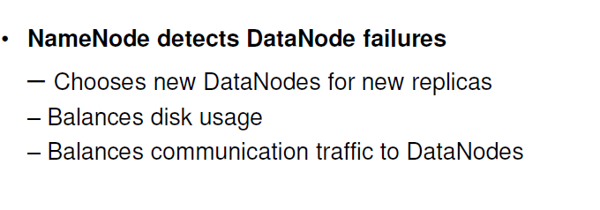
Replication Engines

Slide 49
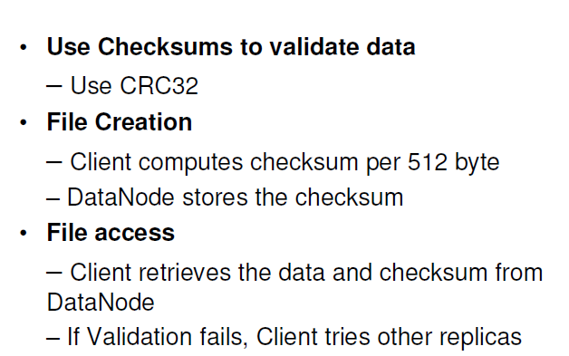
Data Correctness

Slide 50
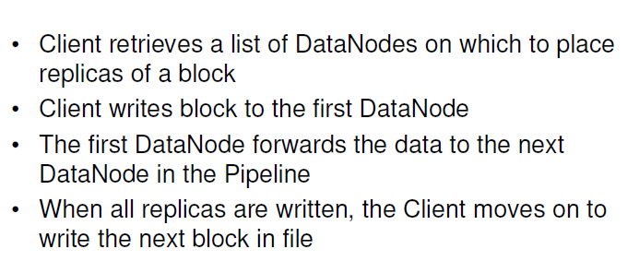
Data Pipelines

Slide 51
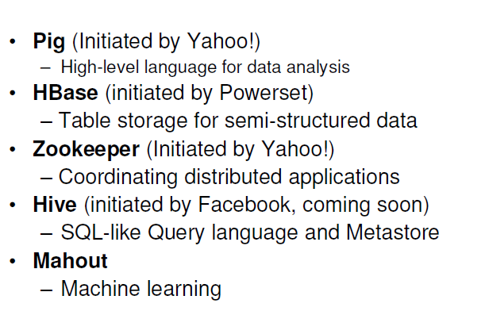
Hadoop Subprojects

Slide 52
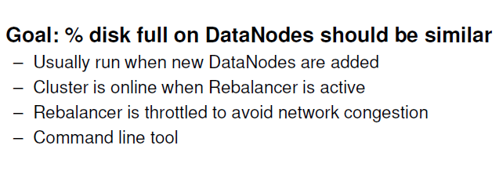
Rebalancer

Slide 53
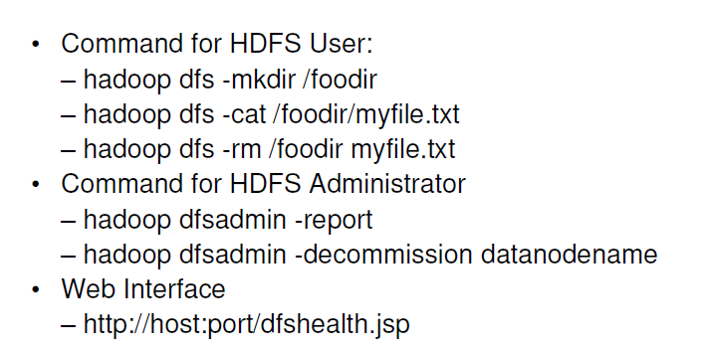
User Interface

Slide 54
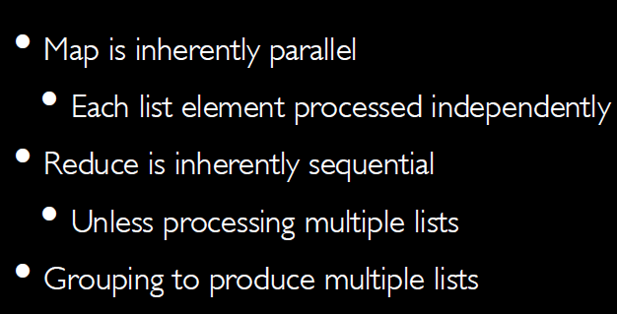
Parallelisms

Slide 55
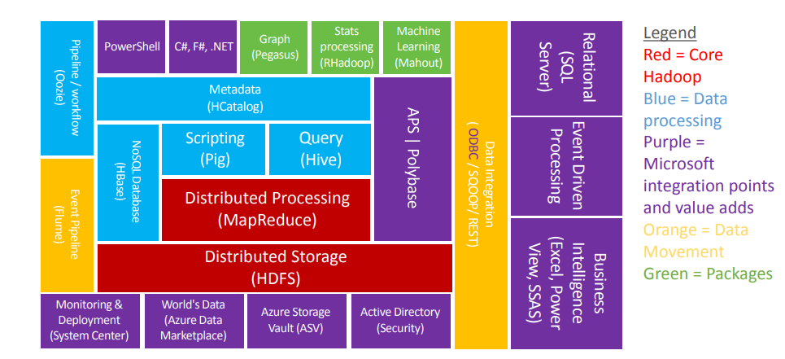
Hadoop Ecosystem

Slide 56
Secondary NameNode & Checkpointing
Checkpointing is a process of combining edit logs with FsImage
Secondary NameNode takes over the responsibility of checkpointing, therefore, making NameNode more available
Allows faster Failover as it prevents edit logs from getting too huge
Checkpointing happens periodically
(default: 1 hour)
NameNode
Secondary NameNode
editLog
editLog
fsImage
First time copy
fsImage
editLog
(new)
FsImage
(final)
Temporary
During checkpoint

Slide 57
How The Data Is Actually Stored
In Datanodes?
HDFS Data Blocks

Slide 58
6
HDFS Data Blocks

Slide 59
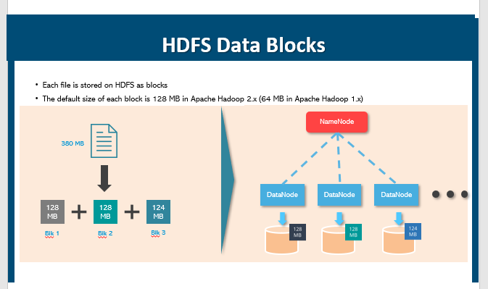

Slide 60
Fault Tolerance: How Hadoop copes up with DataNode Failure?

Slide 61

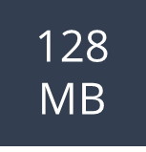
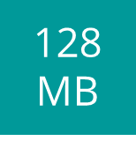
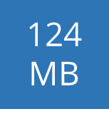
Fault Tolerance
Scenario:
One of the DataNodes crashed containing the data blocks
NameNode
128
MB
128
MB
124
MB
DataNode
DataNode
DataNode
DataNode

Slide 62
Solution: Replication Factor

Slide 63

Replication Factor
NameNode
Solution:
Each data blocks are replicated (thrice by default) and are distributed across different DataNodes
DataNode
DataNode
DataNode
DataNode
128
MB
128
MB
124
MB
128
MB
124
MB
128
MB
124
MB
128
MB
128
MB
124
MB

Slide 64
7
HDFS Read & Write Mechanism

Slide 65
HDFS Write Mechanism

Slide 66
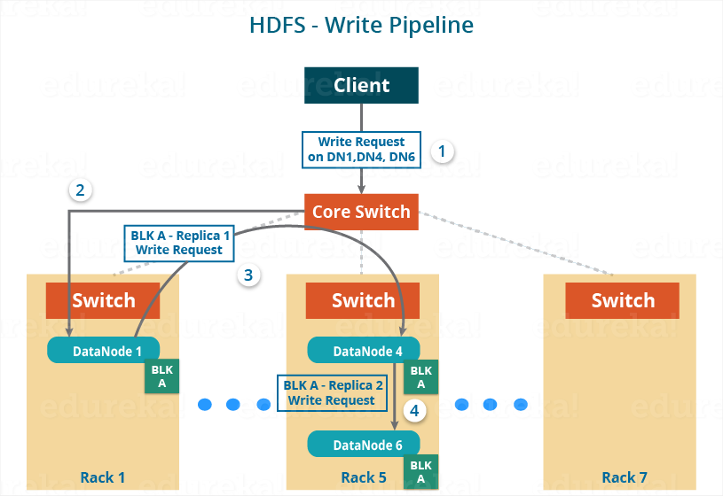
HDFS Write Mechanism – Writing a Block

Slide 67
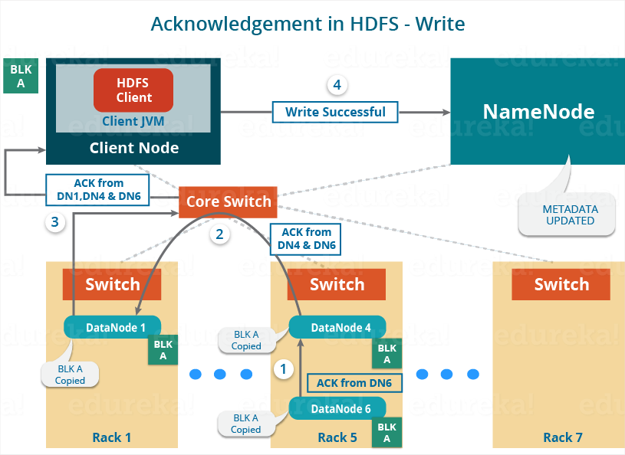
HDFS Write Mechanism – Acknowledgement

Slide 68
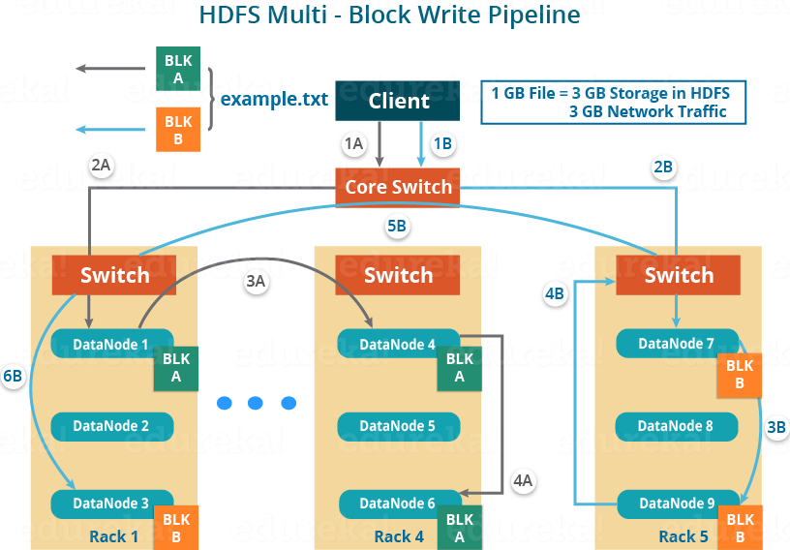
HDFS Multi Block Write Mechanism
For Block A: 1A -> 2A -> 3A -> 4A
For Block B: 1B -> 2B -> 3B -> 4B -> 5B -> 6B

Slide 69
HDFS Read Mechanism

Slide 70
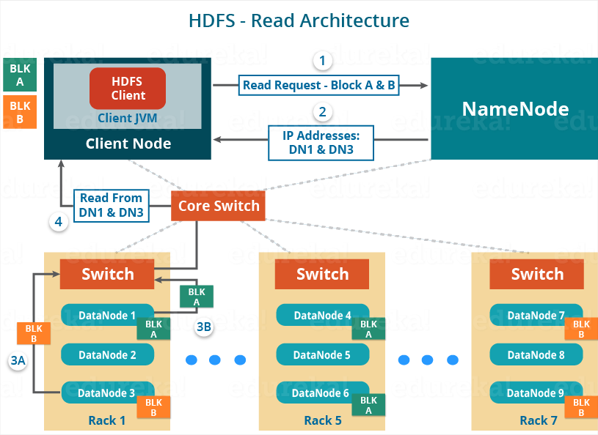
HDFS Read Mechanism

